Slide 1

Building the Perfect
Crypto Portfolio
Group 3: Neil Baride, Jason Brunsell, & Mike Colbert

Slide 2
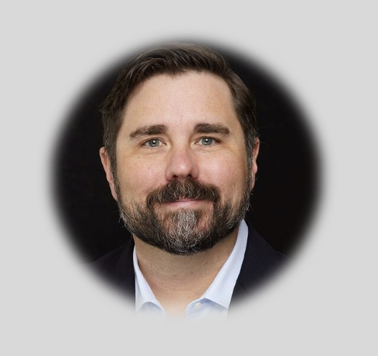
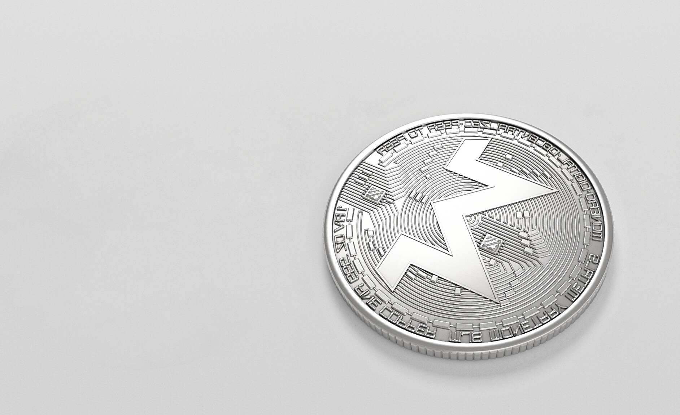


2.
The Financial Advisors
Jason Brunsell
Michael Colbert
Neil Baride

Slide 3

DISCLAIMER
This tool is for educational or informational purposes only and does not constitute financial advice
** Before investing in cryptocurrencies, individuals should conduct thorough research, understand the risks involved, and consider their risk tolerance and investment objectives. Diversification, risk management strategies, and staying informed about market developments are crucial aspects of managing these risks. It's advisable to consult with financial professionals for personalized advice based on individual circumstances.**

Slide 4



3.
Understanding Cryptocurrency
Cryptocurrency
Decentralized Networks
Blockchain
Digital Money - Virtual
Use of Blockchain Technology
Digital Database Stores Data Blocks

Slide 5
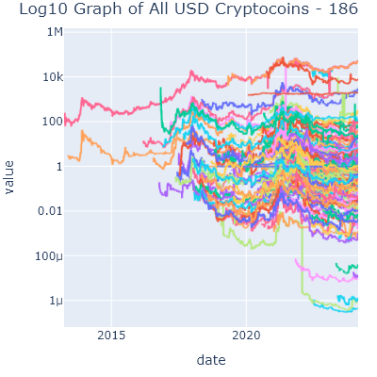

4.
All the coins! - data clean up
Data Characteristics:
We started with 186 cryptocurrencies.
The API provided us with the date (as mts), close, high , low , open, and volume.
After the filter we end up with 30 “Good Coins”. These are coins we deem worthy of being considered for our portfolio based on their return and risk factor.
After the portfolio is optimized we end up with 6 coins to invest.
The API provided the transaction date and time in “mts” so we have to convert this to a usable datetime format for our graphs.

Slide 6

5.
The purpose of our tool
Client's Cryptocurrency Portfolio Taking information from API Bitfinex | Market Conditions Economic Environment Market Trends Assets Performance
Calculation of Coin Purchase Expected Return | Investment Strategy Investing Growth Trading
Aims Maximize Returns based on level of risk Highest Possible Returns | Capital Allocation Directing funds Return & Risk
Notes:
Optimize a client's cryptocurrency portfoliO by taking information from the API Bitfinex and using this to calculate how much of each coin you should purchase and what type of returns you may expect to see. Portfolio optimization aims to maximize returns for a given level of risk.
By optimizing your cryptocurrency holdings, you seek to achieve the highest possible returns based on your risk preferences. Portfolio optimization also allows you to adapt to changing market conditions. It enables you to adjust your holdings based on the evolving economic environment, market trends, and the performance of different assets.
Optimization helps ensure that your portfolio is aligned with your chosen investment strategy as well, whether it's value investing, growth investing, or a specific trading approach.Optimizing also helps ensure that your capital is allocated efficiently, directing funds to assets with the potential for higher returns relative to their risk.

Slide 7
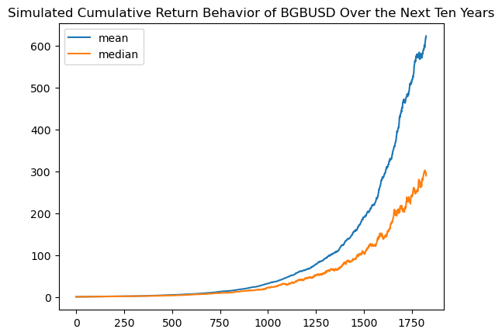
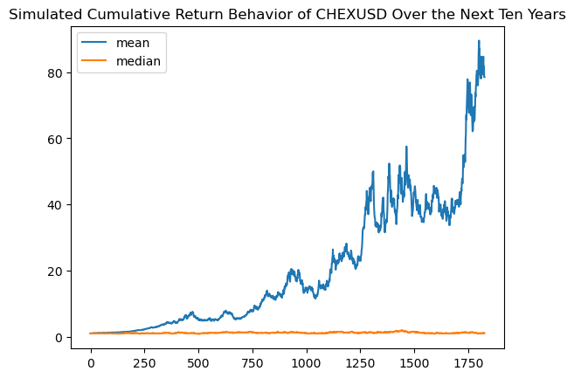
6.
GOOD COIN VS BAD COIN
The mean and median remain close over time in a coin that is more stable and will have less risk

Slide 8

7.
SHARPE RATIO
1.
The Sharpe ratio is a widely used measure in finance to assess the risk-adjusted performance of an investment portfolio.
2.
Risk-Adjusted Returns: The Sharpe ratio takes into account not only the total return of an investment but also its volatility or risk. By using this ratio, you are assessing the performance of your portfolio in relation to the amount of risk you are taking.
3.
Comparative Analysis: The Sharpe ratio allows for the comparison of different portfolios. Investors can use it to compare the risk-adjusted performance of various investment strategies or asset allocations. This helps in making informed decisions about which portfolio might offer the best risk-return trade-off.
4.
Volatility Management: Cryptocurrencies are known for their price volatility. The Sharpe ratio helps investors manage this volatility by considering both returns and risk. A portfolio with a higher Sharpe ratio is generally preferred because it implies higher returns for the level of risk taken.

Slide 9

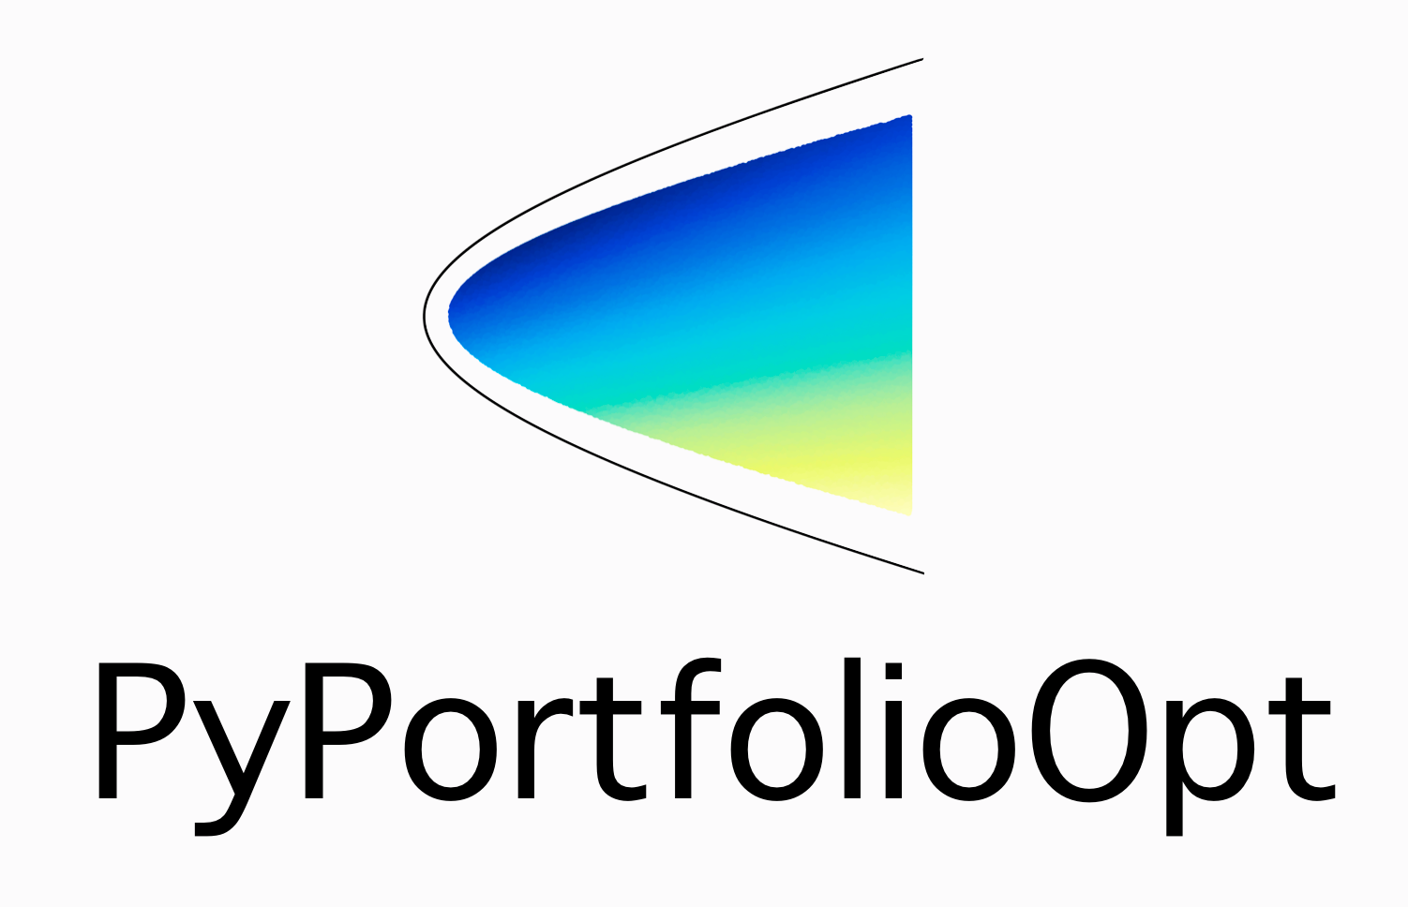
8.
1. Monte Carlo Simulations (MC Forecast Tools) Harness the power of Monte Carlo simulations using the MCForecastTools library. Our platform empowers you to simulate various market scenarios, allowing you to visualize potential portfolio outcomes and make informed decisions based on a range of possible future market conditions.
2.Advanced Portfolio Screening
Our built-in screener efficiently filters through the vast array of cryptocurrencies, identifying promising opportunities while mitigating risks. Distinguish between the high-performing coins and those that may not align with your investment goals.
3.Portfolio Optimization
Introducing the NEW LIBRARY to our toolkit – PyPortfolioOpt. This library enables sophisticated portfolio optimization techniques, considering risk, return, and various constraints. Define your investment goals, set initial investment numbers, and let PyPortfolioOpt craft a tailored portfolio that aligns with your unique risk appetite.
Key features

Slide 10

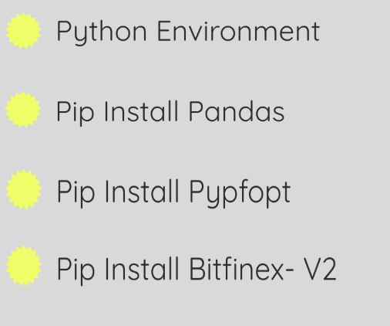
9.
Installs & Dependencies
Clone the repository from github: https://github.com/jbrunsell/Fintech-Project-3.git
To run the provided code, you'll need to install several Python libraries. You can install them using the following commands in your Python environment (you may use a virtual environment for better isolation):

Slide 11
10.
The module named crypto_screener.py is used by crypto_screener_module_tester.ipynb to run our tool.
The tool is used by first unzipping the folder after downloading, then running the file titled crypto_screener_module_tester.ipynb. After defining the screener to retrieve the coins we would like to include, the tool pulls in all of the crypto data and screens it as well.
The next step for our tool is to import the crypto data that was pulled in the previous step and use that data to run the simulations.
After the simulations are complete the client will be able to input their desired investment amount.
The last step is for our tool to send back the results from all of the work it has done. The output will tell the client these things:
The coin counts to purchase
Your leftover dollar amount
Predicted Portfolio Performance:
1. Expected Annual Return
2. Annual Volatility
3. Sharpe Ratio
how to use the tool

Slide 12

Data visualization of portfolio components

Slide 13
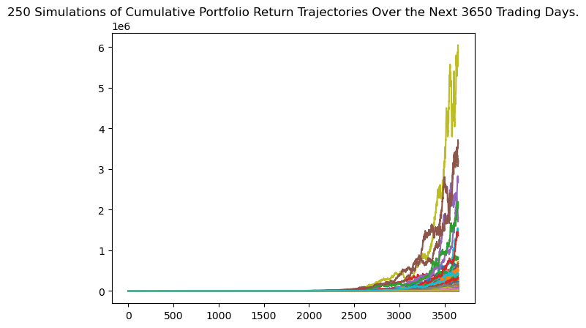
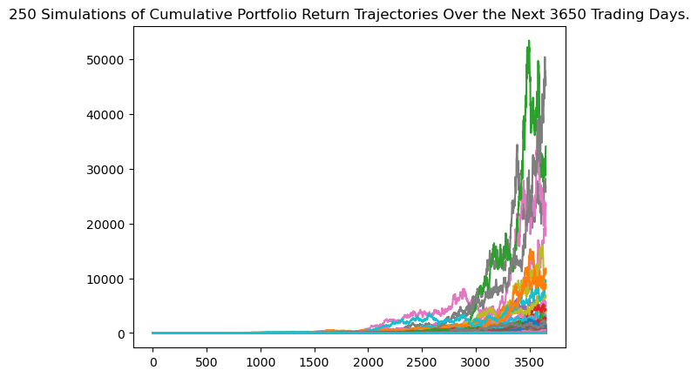
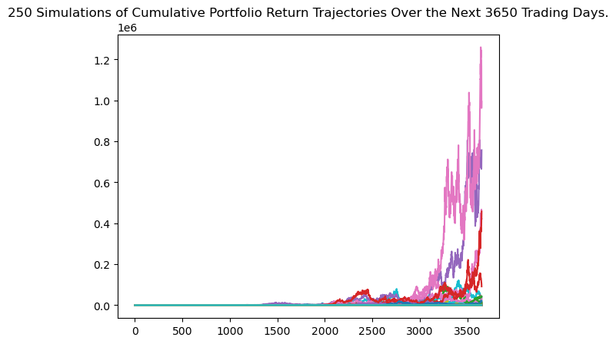
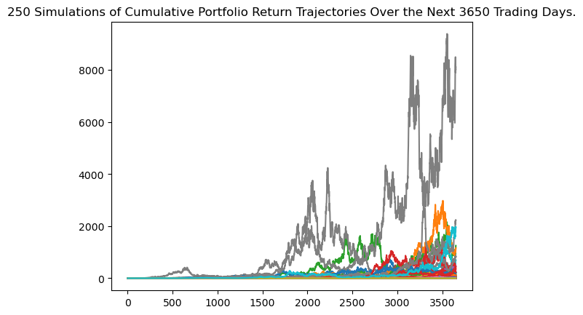
11.
Top coins
BGBUSD
BTCUSD
FLRUSD
WBTUSD

Slide 14
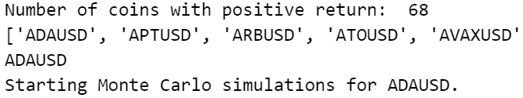
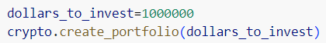
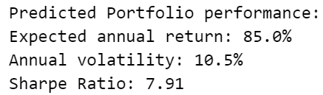
12.
tHE outputs
1.
The name of the coin will appear on the left next to it will be the percentage of coin that should be purchased.
For example ('BGBUSD', 0.91506) shows us the ticker 'BGBUSD' and that 91 percent of our initial investment should go into that coin.
2.
This step the tool will also show how many of the coins you should purchase by number by showing you the individual allocation
For example 'BGBUSD': 82001 shows us the ticker 'BGBUSD' and that we would need to purchase 82001 of those coins.

Slide 15
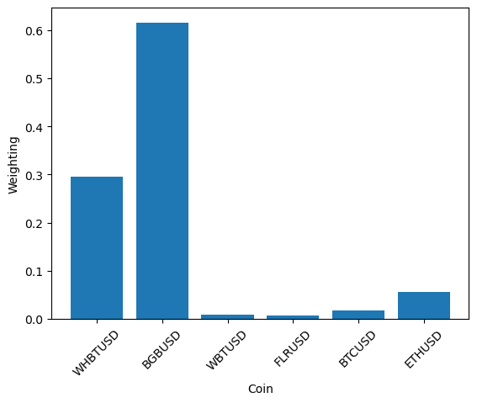
13.
WHAT DOES MY PORTFOLIO LOOK LIKE?
This graph shows:
The weight distribution for each of the final coins.
This is what your optimized portfolio looks like in a graph form.
We can see that:
“BGBUSD” is our main focus with “WHBTUSD” and “ETHUSD” not too far behind.

Slide 16
13.
WHATS NEXT?
Some of the things we could do to further our project would be:
Testing likely returns in a Monte Carlo Simulation using the optimized portfolio. By doing this, we could further our research and optimize our portfolio even more.
We would use a more sophisticated model that would allow us to further filter our coins, to lessen the strain as well as time spent running the program.
Modify the portfolio generation tool to allow for the purchase of fractional coins to ensure the complete use of the initial investment.
Add a monthly reminder to re-optimize the portfolio for comparison.
Track our recommendations for each client and observe how their portfolio performs.

Slide 17
14.
Thank you
With this tool you are ready to go and turn your dream portfolio into reality!
Always remember that the market can change due to unforeseen circumstances and it is suggested that you use this tool in combination with your own research as well a consistent eye on the public knowledge of the market.Thanks for using our tool and happy trading!

